Slide 1
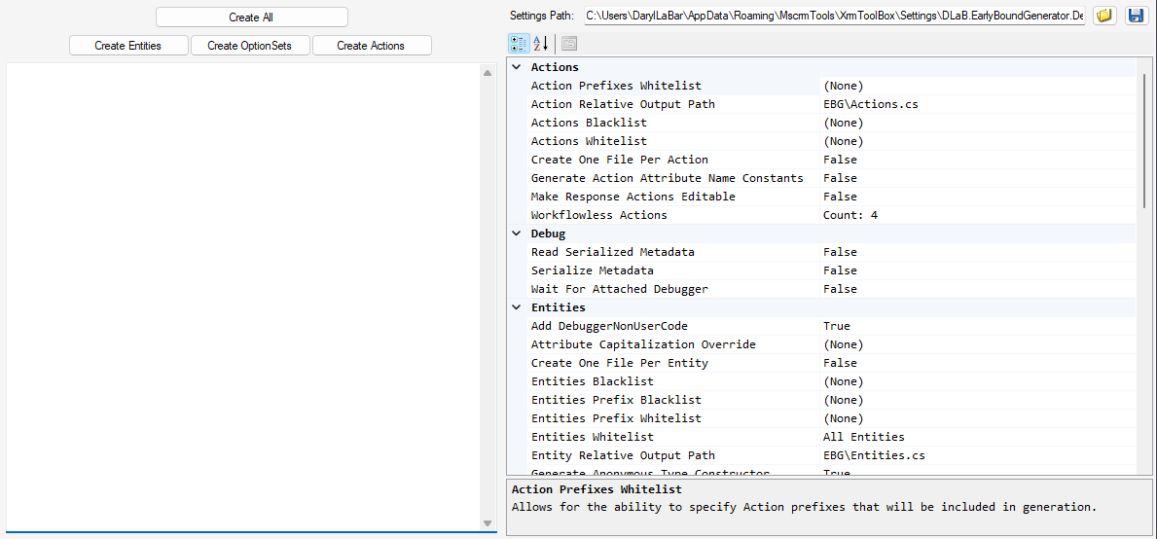
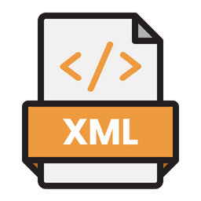

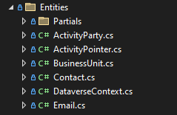


Earlybound Generator Flow
Loads and
Saves to
EBG Settings Path
On “Create” button click, first, writes
to
On “Create” button click, second, calls ModelBuilder Invoker
Generates
Earlybound classes
Is consumed by
Microsoft.PowerPlatform
.Dataverse.ModelBuilderLib
Is consumed by
builderSettings.json
DLaB.ModelBuilder Extensions

Slide 2

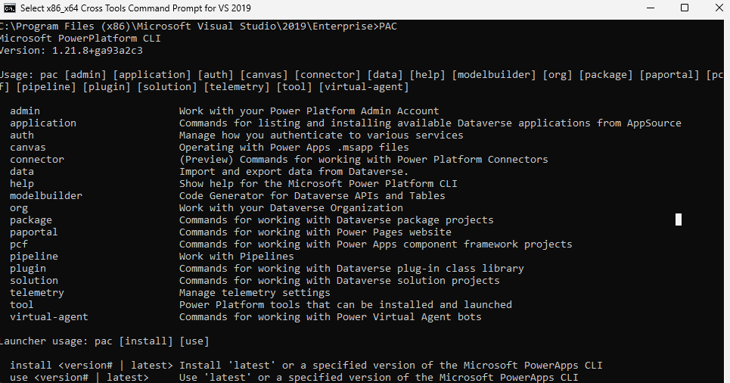
PAC CLI Build Flow
1. Manually populate builderSettings.json, or copy from EBG
2. Copy DLaB.ModelBuilder.Extensions.dll to PAC folder
3. Run PAC modelbuilder build command line
Is consumed by
Generates
Earlybound classes
Is consumed by
builderSettings.json
DLaB.ModelBuilder Extensions

